Slide 1
PH2XX: WPRX Grade Brief

Slide 2
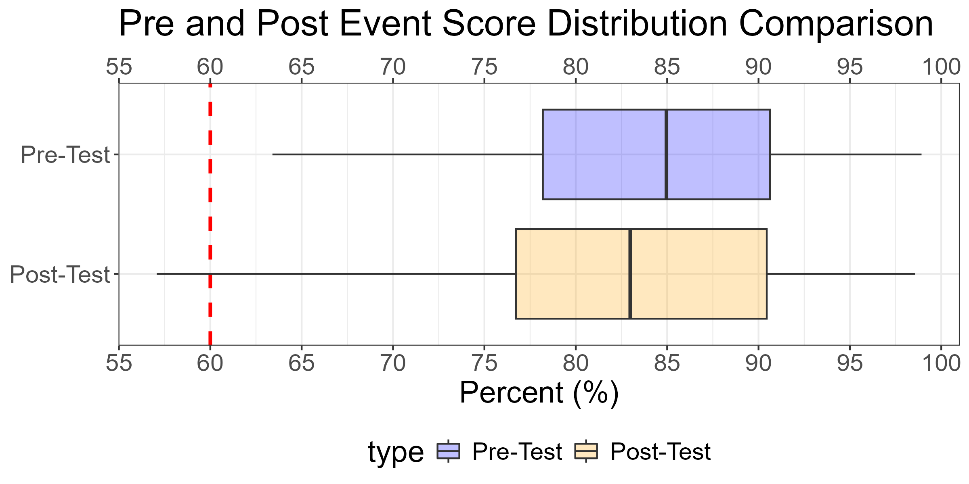
Pre/Post Course Score Comparisons
Grade | F | D | C- | C | C+ | B- | B | B+ | A- | A | A+
Pre Count | 0 | 1 | 3 | 3 | 10 | 9 | 11 | 9 | 15 | 3 | 5
Post Count | 1 | 2 | 5 | 2 | 12 | 8 | 9 | 9 | 13 | 2 | 6
Percent Change% | Inf% | 100% | 67% | -33% | 20% | -11% | -18% | 0% | -13% | -33% | 20%
PRE D/F's: | PRE D/F's: | PRE D/F's: | 1 (1.4%) | 1 (1.4%) | 1 (1.4%) | PRE A's: | PRE A's: | PRE A's: | 23 (33.3%) | 23 (33.3%) | 23 (33.3%)
POST D/F's: | POST D/F's: | POST D/F's: | 3 (4%) | 3 (4%) | 3 (4%) | POST A's: | POST A's: | POST A's: | 21 (30%) | 21 (30%) | 21 (30%)
Type | Number | Average | Median | Min | Max
Pre | 69 | 84.1 | 85.0 | 63.4 | 98.9
Post | 69 | 82.5 | 83.0 | 57.1 | 98.6

Slide 3
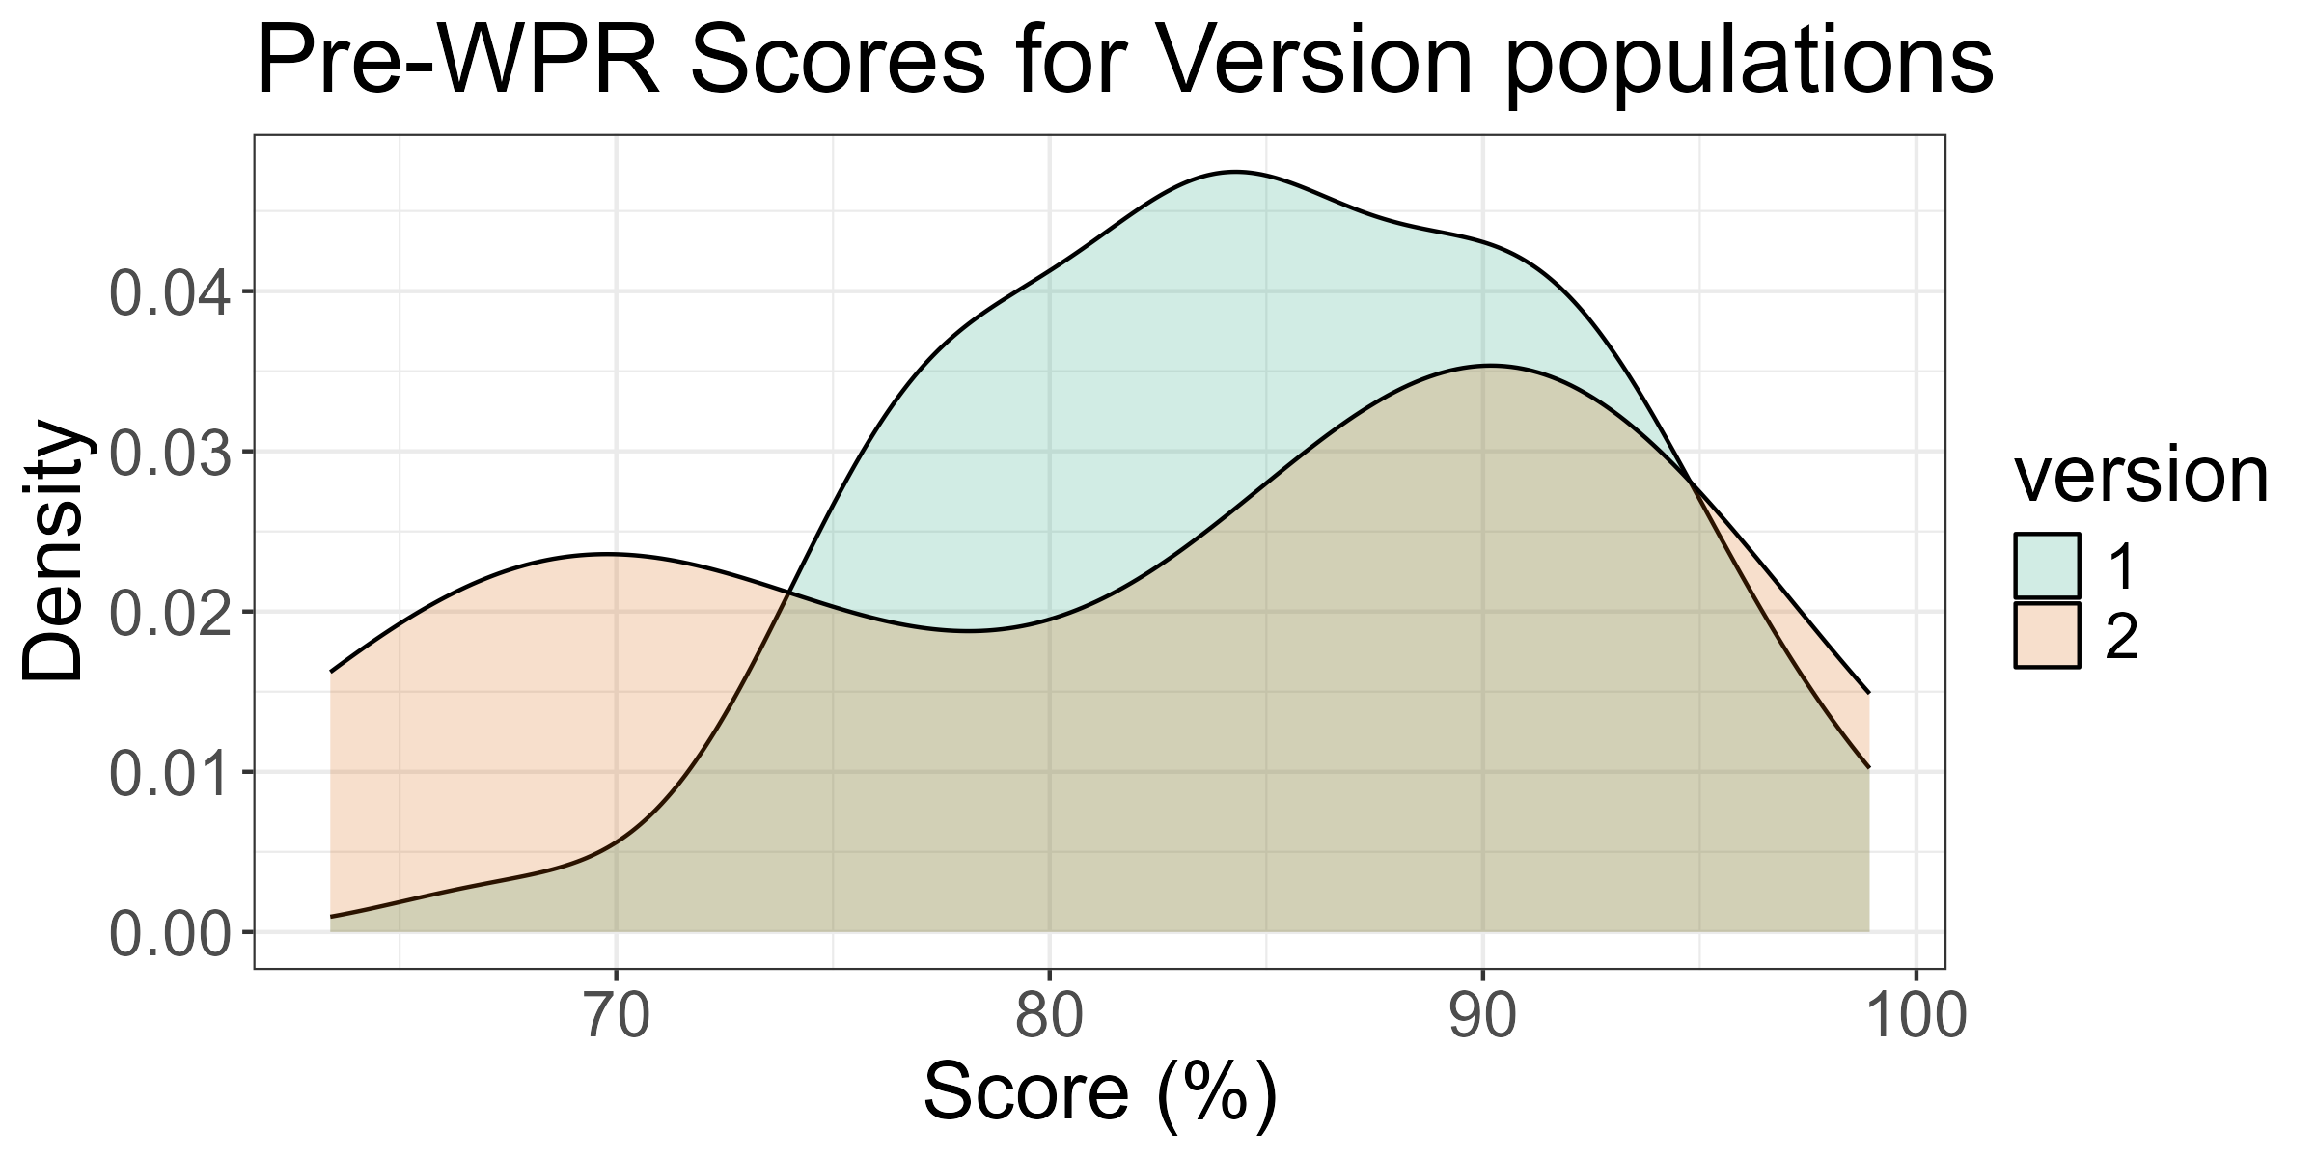
Pre Score Comparisons between versions
version | Count | Mean (%) | Median (%) | Std. Dev (%) | # D/F's | # A's
1 | 51 | 85.0 | 85.0 | 7.0 | 0 (0%) | 20 (39%)
2 | 18 | 81.6 | 86.3 | 11.0 | 1 (6%) | 9 (50%)
Method | result | t_value | p_value
Welch Two Sample t-test | difference in means between group 1 and group 2 | 1.212 | 2.38e-01

Slide 4
Cadets not accounted for in this brief
Cadet Name | Instructor | Section
Garcia, Manuel | MAJ Taylor Bruff | A1B1
Harris, Oliver | MAJ Taylor Bruff | A1B1
Yousefzadeh, Christian | LTC Jacob Capps | A1B1
Lyons, Gage | MAJ Taylor Bruff | A2B2

Slide 5
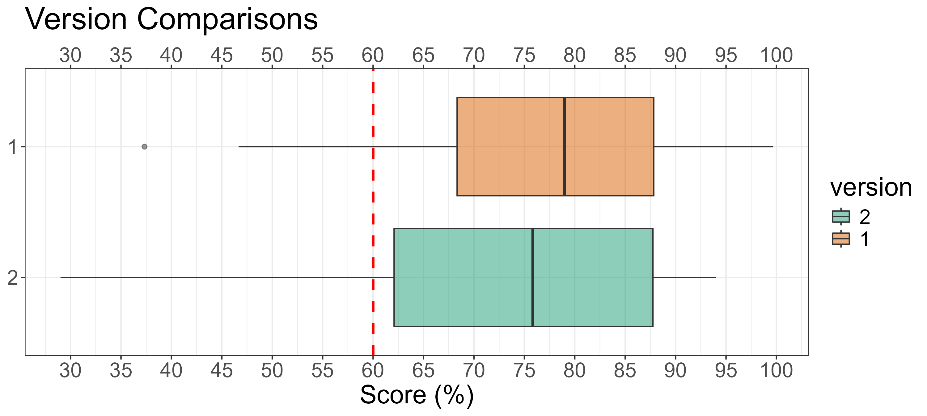
WPR Version Comparisons
version | Count | Mean (%) | Median (%) | Std. Dev (%) | Min (%) | Max (%) | # D/F's | # A's
1 | 51 | 76.8 | 79.0 | 14.3 | 37.3 | 99.7 | 11 (22%) | 13 (25%)
2 | 18 | 71.5 | 75.8 | 20.0 | 29.0 | 94.0 | 5 (28%) | 5 (28%)

Slide 6
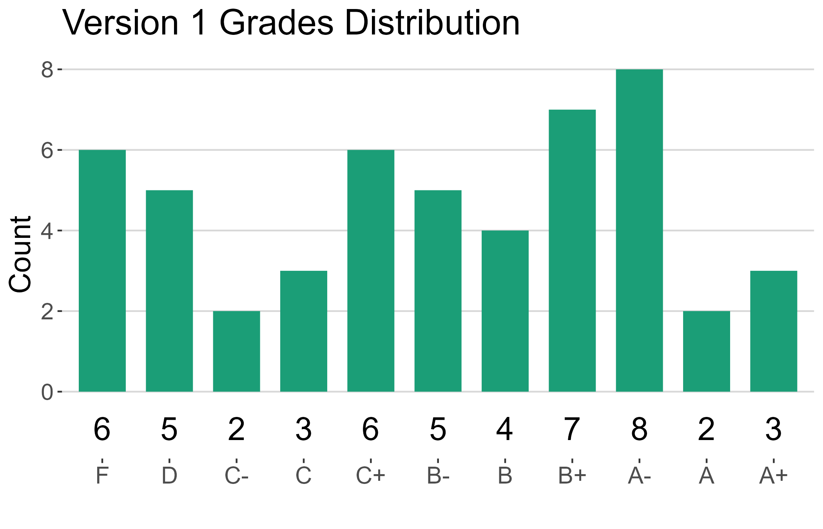
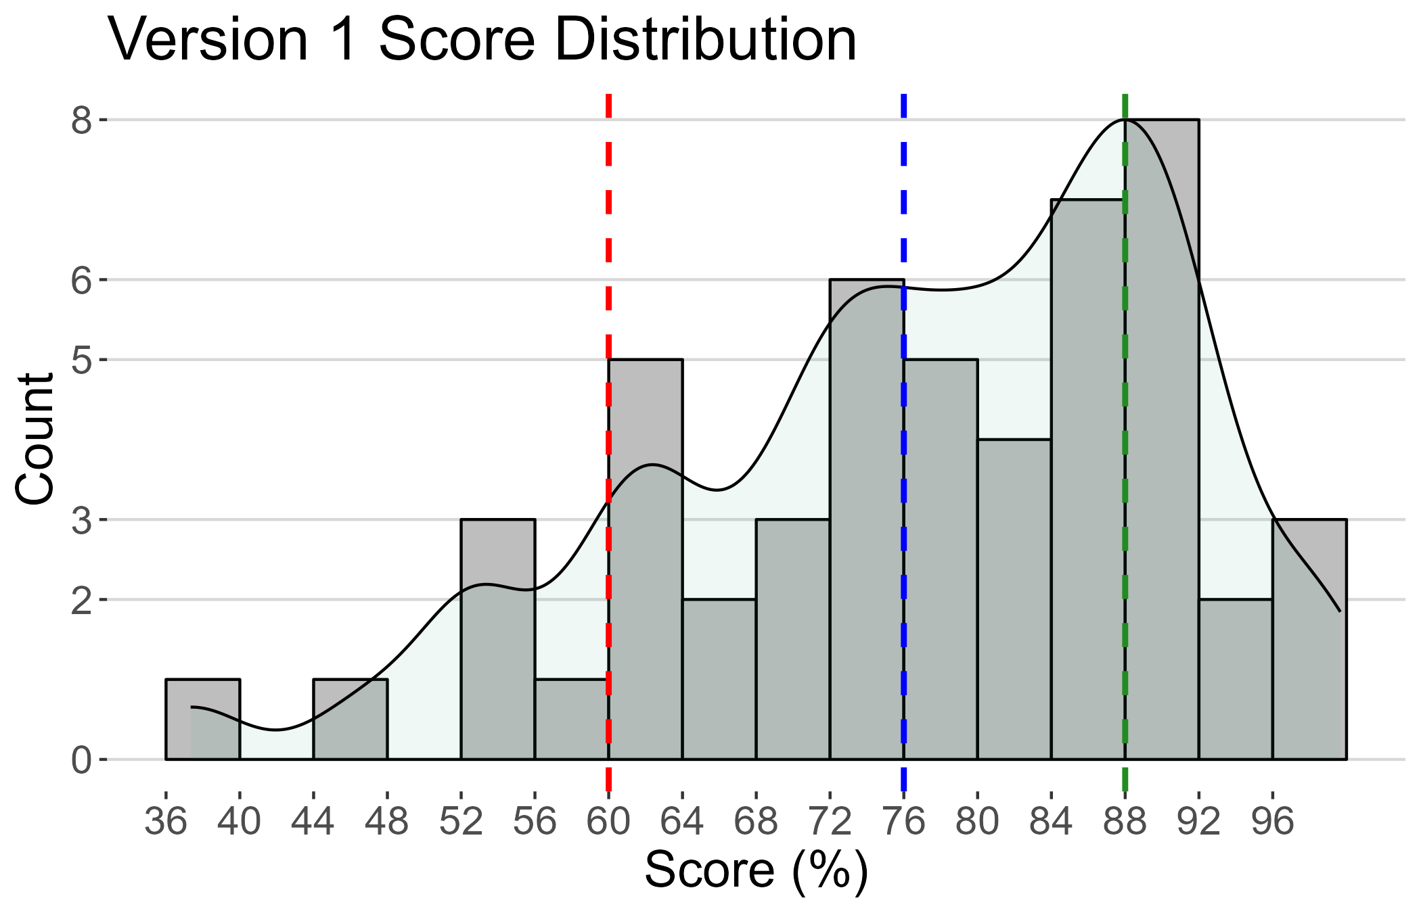
Version 1 Summary
version | Count | Mean (%) | Median (%) | Std. Dev (%) | Min (%) | Max (%) | # D/F's | # A's

Slide 7
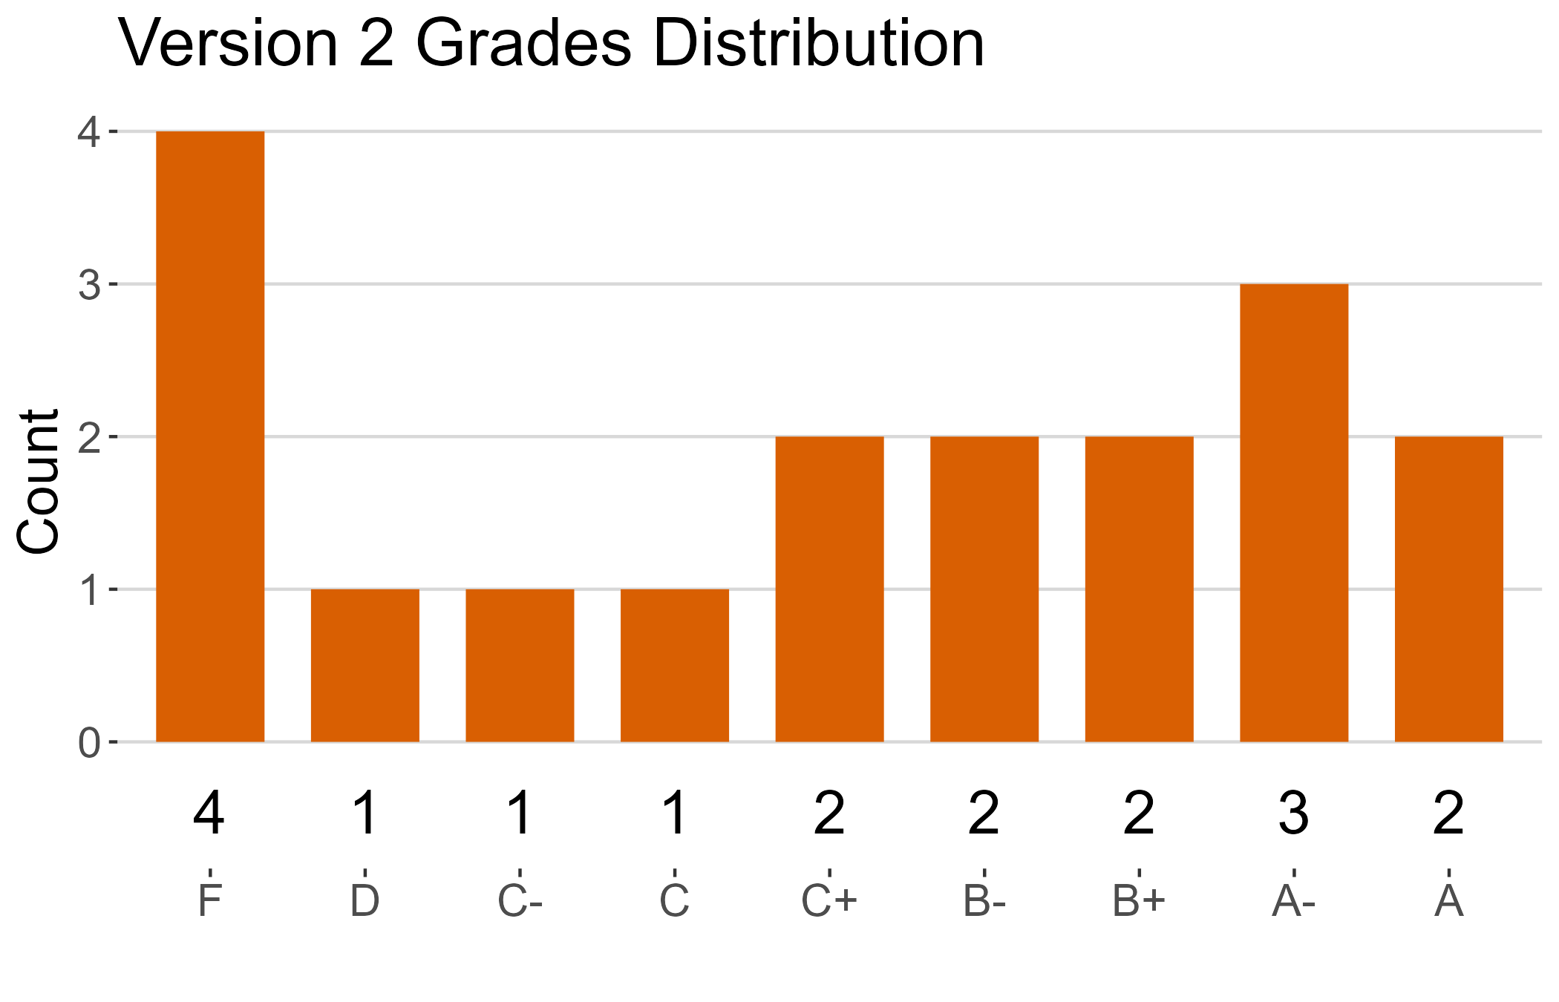
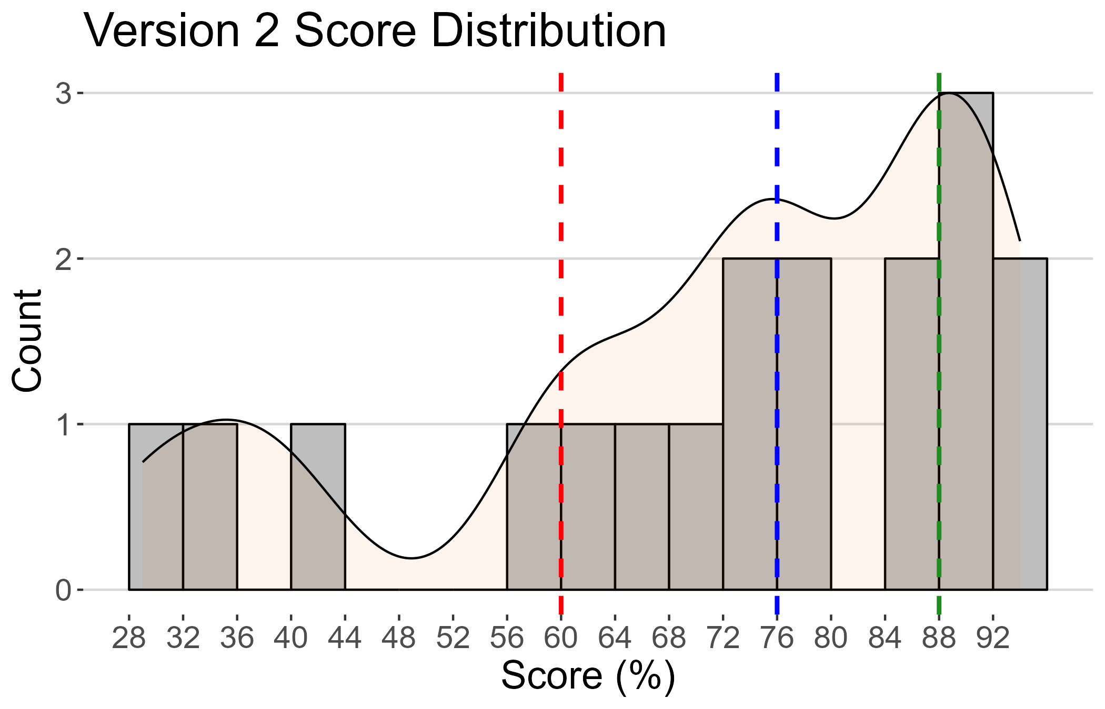
Version 2 Summary
version | Count | Mean (%) | Median (%) | Std. Dev (%) | Min (%) | Max (%) | # D/F's | # A's

Slide 8
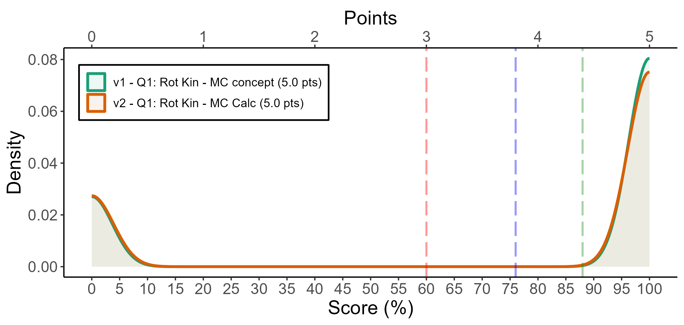
a
 | F | D | C- | C | C+ | B- | B | B+ | A- | A | A+
v1 | 80 | 0 | 0 | 0 | 0 | 0 | 0 | 0 | 0 | 0 | 238
v2 | 74 | 0 | 0 | 0 | 0 | 0 | 0 | 0 | 0 | 0 | 203
# | Pts | Cut | Applied (%)
V2 - Q2 | 0 | Correct (D) | 95
V1 - Q2 | 0 | Correct (Option D) | 81
V1 - Q1 | 0 | Correct (Option C) | 75
V2 - Q1 | 0 | Correct (A) | 74
V1 - Q1 | 5 | Incorrect (Option A | 25
V2 - Q1 | 5 | Incorrect (B) | 18
version | Count | Mean | SD | # D/F's | # A's
v1 | 318 | 74.8 | 43.5 | 80 (25%) | 238 (75%)
v2 | 277 | 73.3 | 44.3 | 74 (27%) | 203 (73%)

